Slide 1
Alzheimer and health age dataset observation
Lai Shan Leung

Slide 2
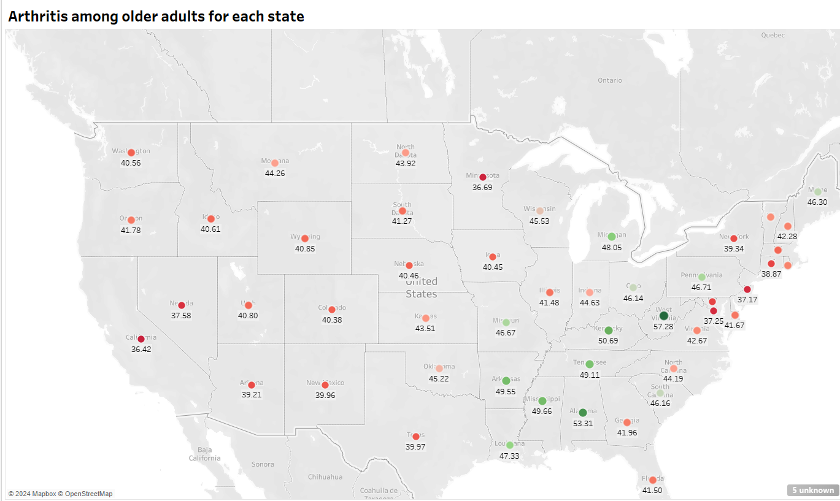
The data suggests that West Virginia exhibits the highest prevalence of arthritis among older individuals. Additionally, the concentration of green points appears to be skewed towards the right-hand side of the image. This clustering might be attributed to proximity to coastal regions.

Slide 3
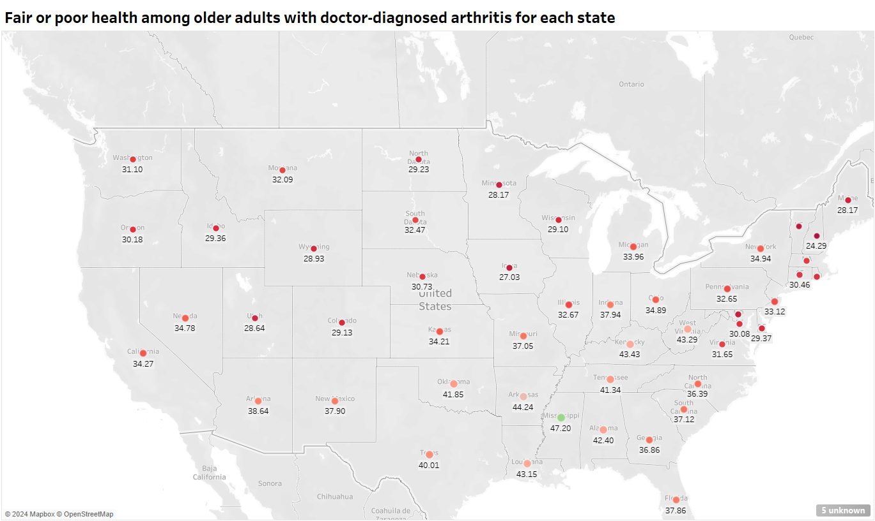
Based on this image, we can infer that the distribution of light pink dots closely resembles that of the previous slide. This consistency indicates the importance of arthritis prevention measures.

Slide 4
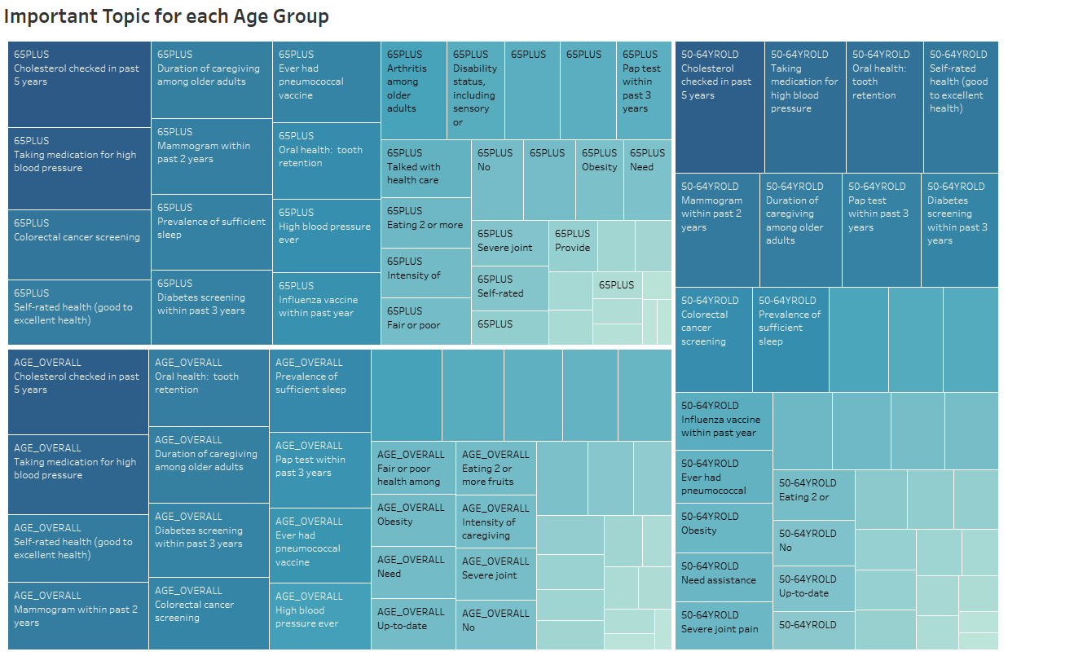
Cholesterol checked in past 5 year, taking medication for high blood pressure and self rated health are the top 5 topics among each group.

Slide 5
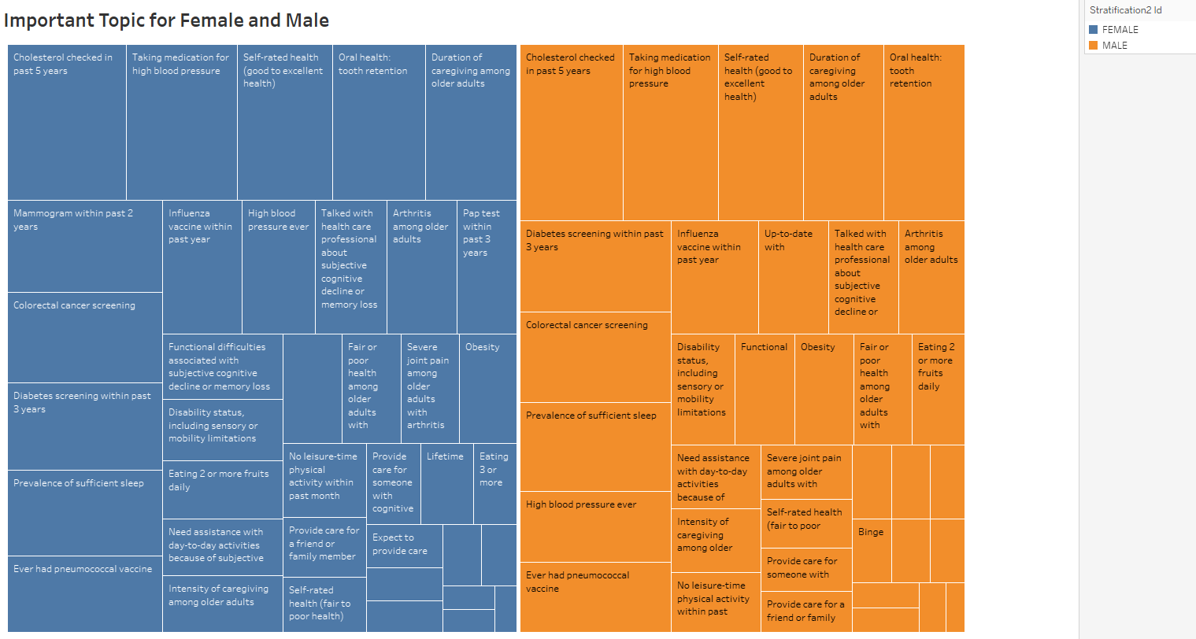
While genders may exhibit slight variations in concerns, the top three concerns remain homogeneous.

Slide 6
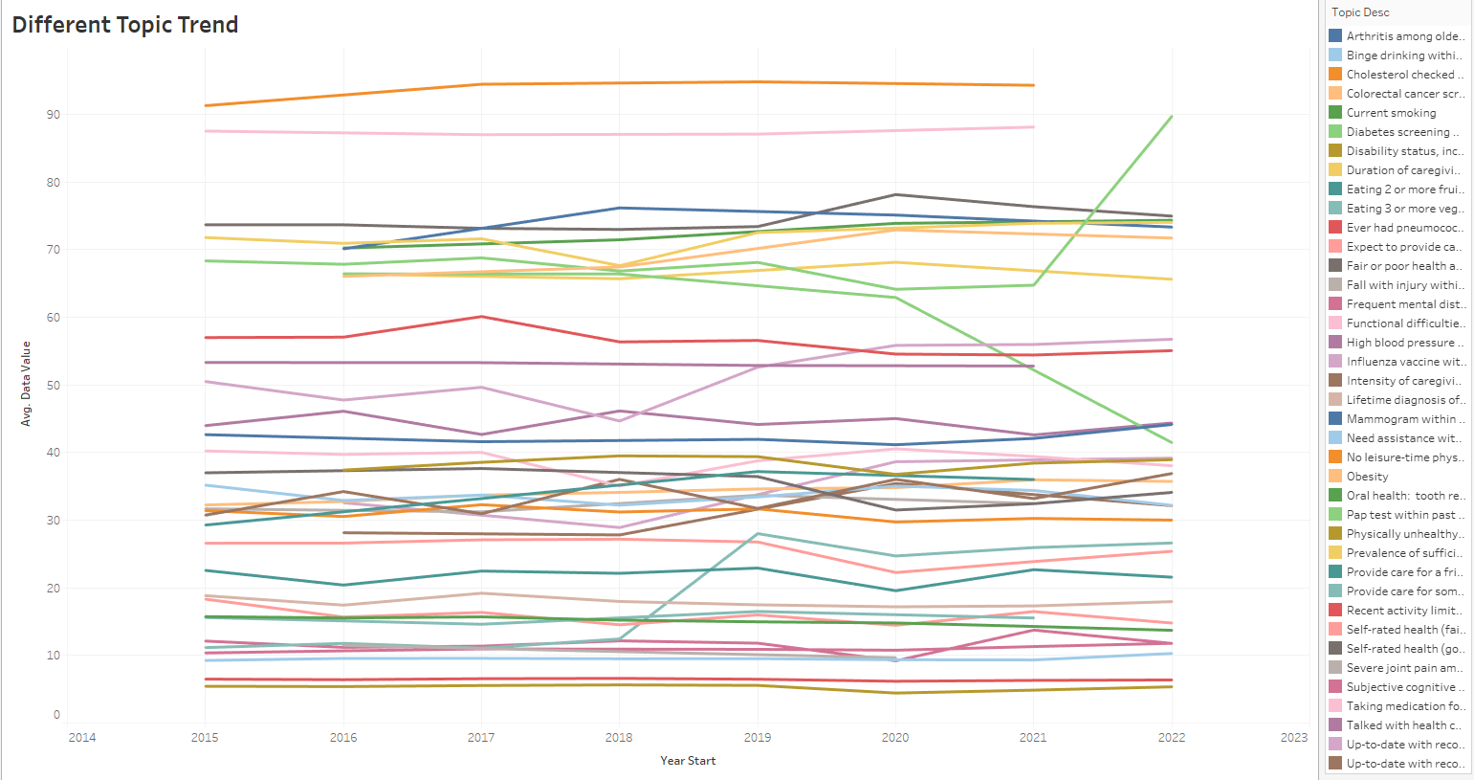
Here are the various trends for each topic. We can observe the trend of wild fluctuations.

Slide 7
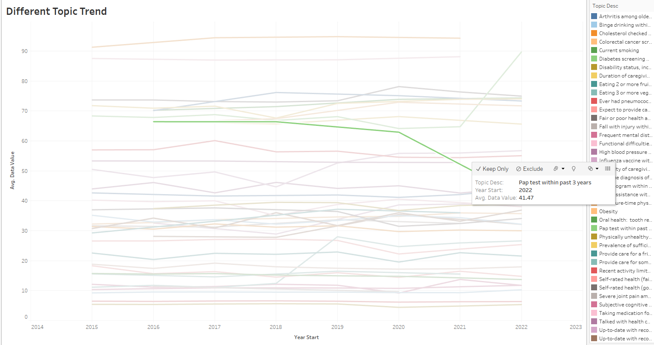
The decline in Pap tests within the past 3 years, observed from 2020 to 2022, may be attributed to factors such as insufficient awareness and a lack of recommendation from healthcare professionals.
https://www.cancer.gov/news-events/cancer-currents-blog/2022/overdue-cervical-cancer-screening-increasing

Slide 8
Conclusion
Location plays a crucial role in potentially causing health problems.
While concerns vary in order across gender and age groups, they share a fundamental homogeneity.
The trends in health topics are significantly influenced by both public awareness and healthcare providers.

